Slide 1
Supervised Models Part 1
Dr. Nassim Sohaee

Slide 2
Supervised models
Classification
Predict class labels
Regression
Predict a continuous number

Slide 3
Classification
Binary classification
Multi-class classification

Slide 4
Generalization, Overfitting, and Underfitting
Generalization ability refers to an algorithm's ability to give accurate predictions for new, previously unseen data.
Assumptions:
Future unseen data (test set) will have the same properties as the current training sets.
Thus, models that are accurate on the training set are expected to be accurate on the test set.
But that may not happen if the trained model is tuned too specifically to the training set.
Models that are too complex for the amount of training data available are said to overfit and are not likely to generalize well to new examples.
Models that are too simple, that don't even do well on the training data, are said to underfit and also not likely to generalize well.

Slide 5
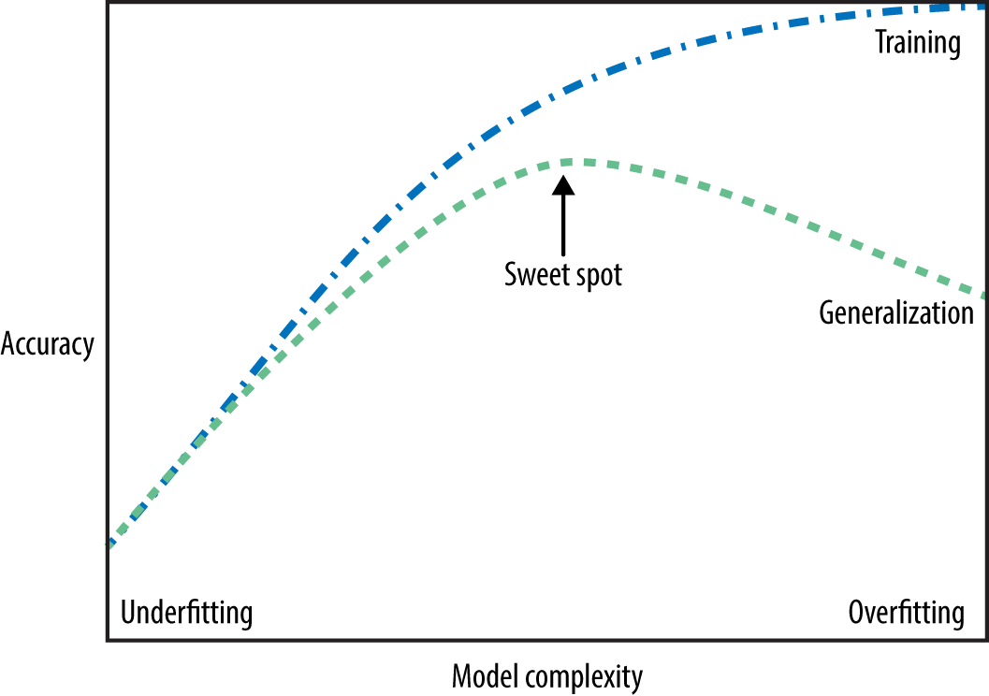
Generalization
Overfitting
Low test score
Complex models
Under fitting
Low test and train score

Slide 6
Supervised Learning

Slide 7
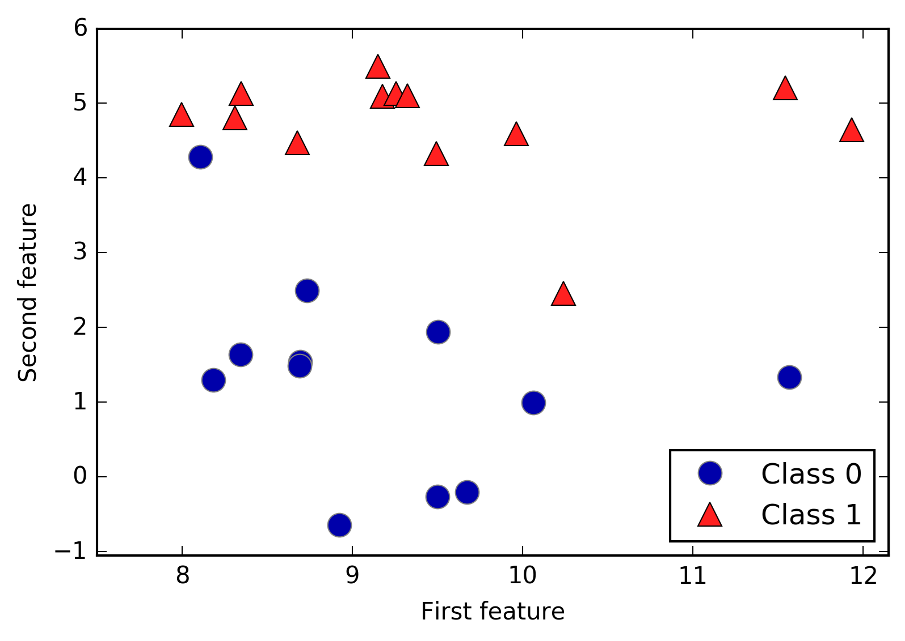
K Nearest Neighbor Classification

Slide 8
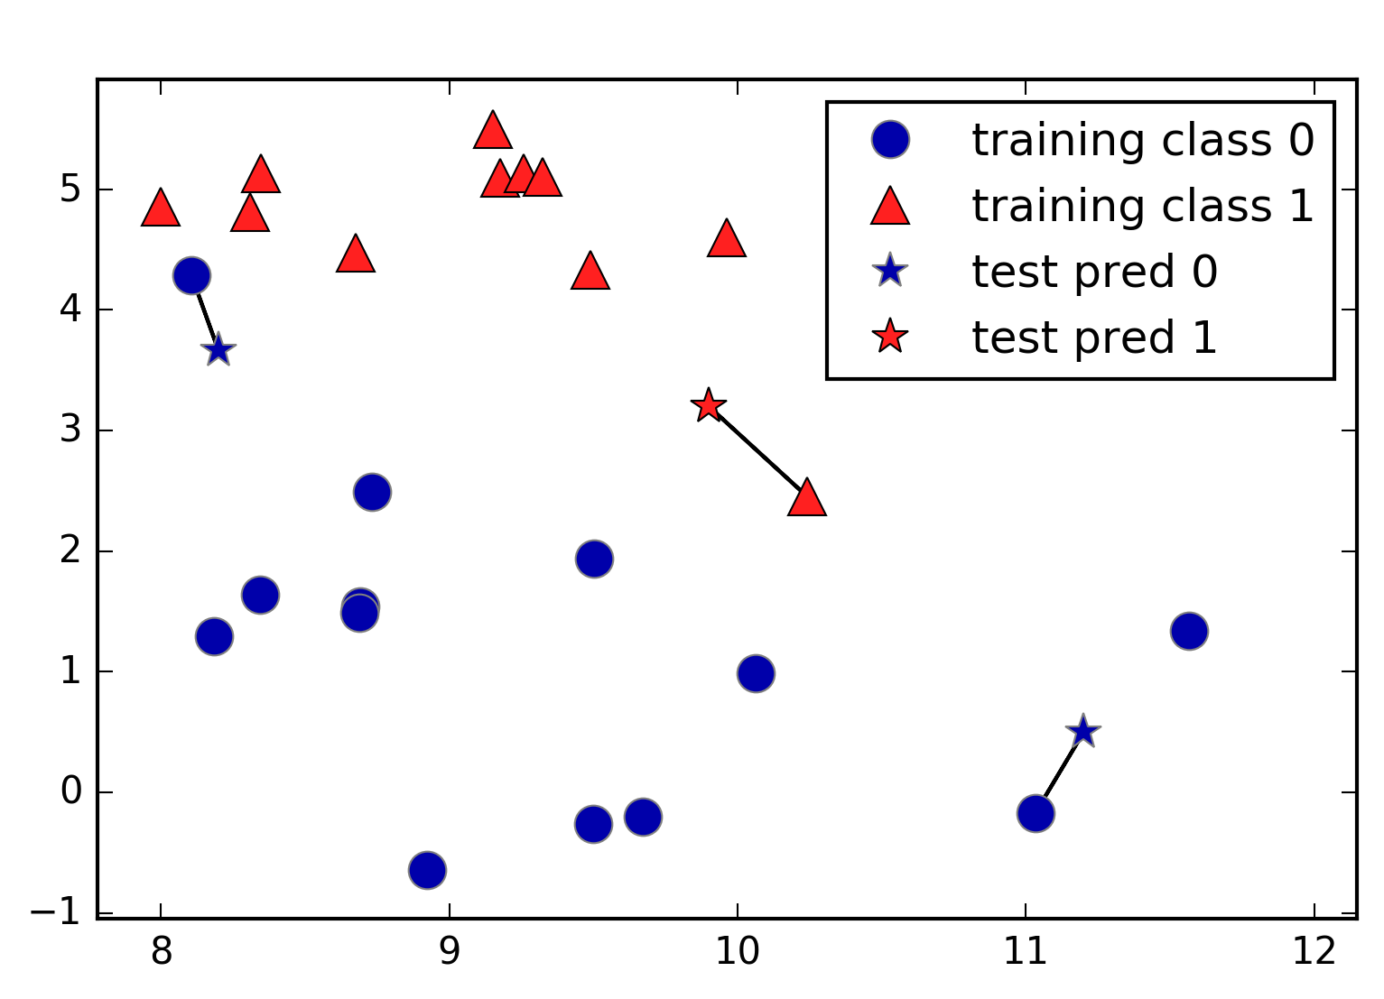
n_neighbors = 1

Slide 9
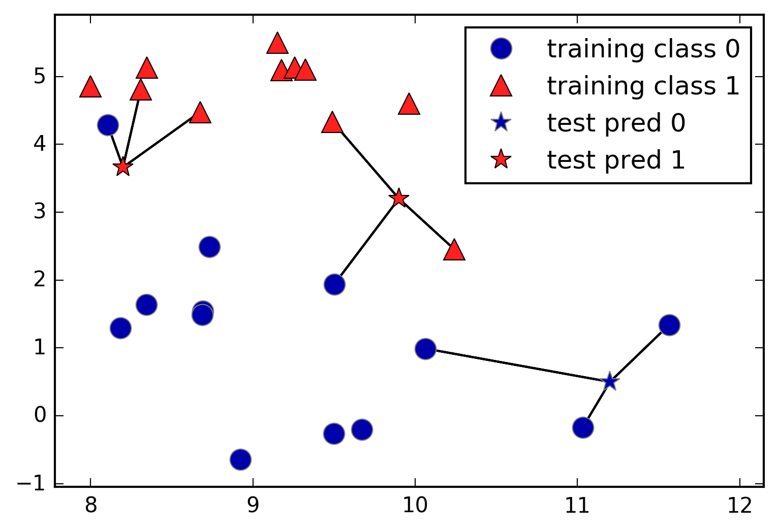
n_neighbors = 3

Slide 10
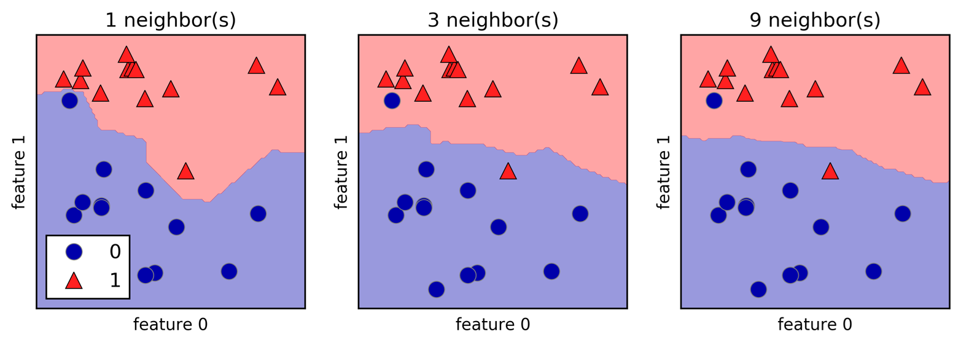
Analyzing KNeighborsClassifier

Slide 11
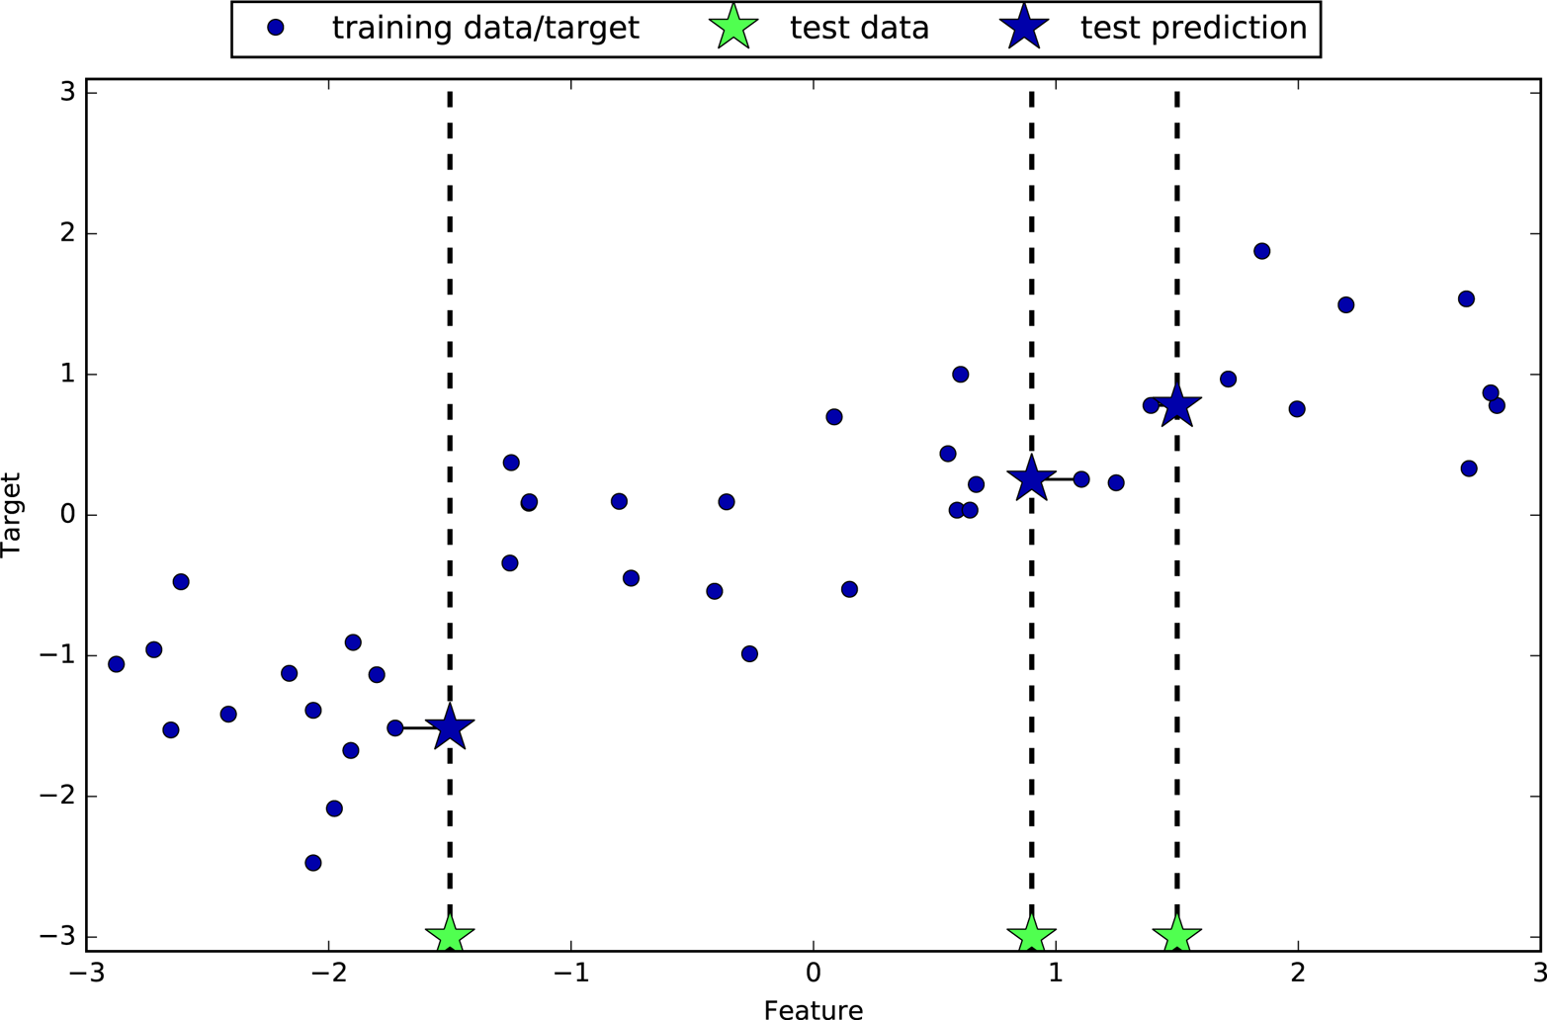
K Neighbors Regression

Slide 12
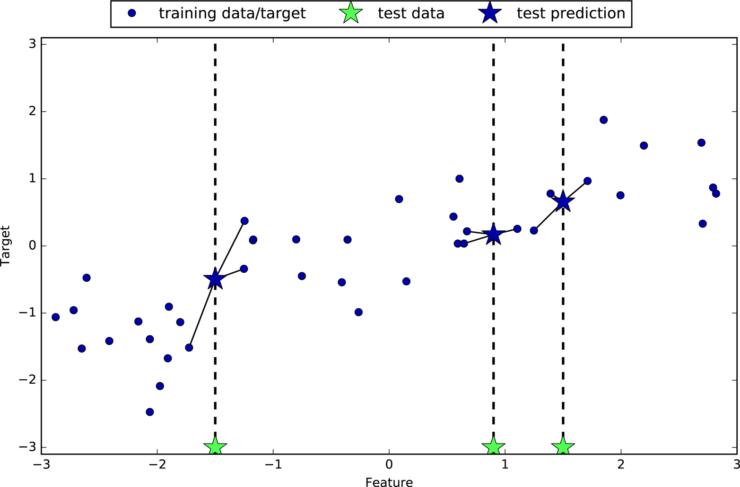
n_neighobors = 3

Slide 13
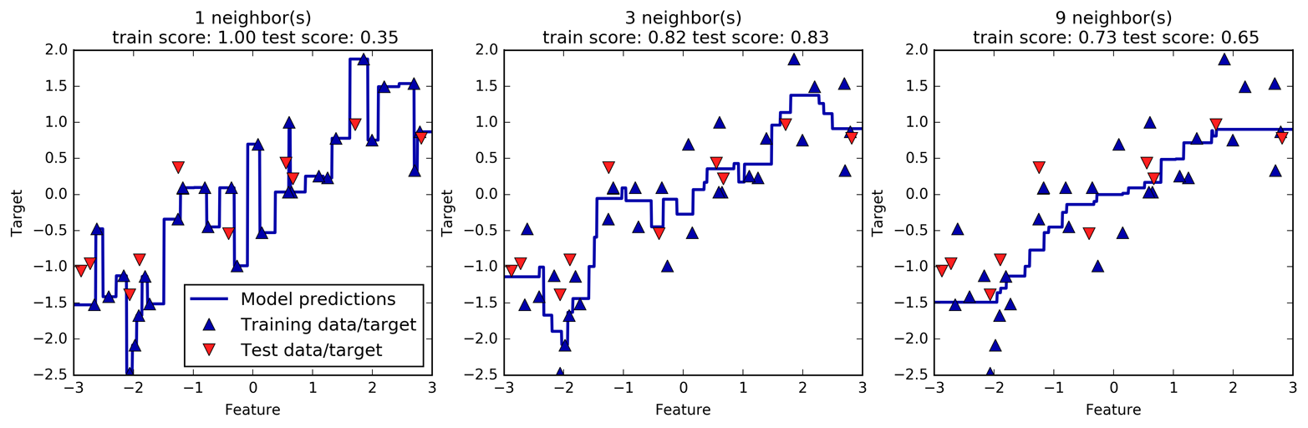
Analyzing KNeighborsRegressor

Slide 14
Strength, weakness and parameters
Parameters:
Number of neighbors
Metric
Strength:
Easy
Weakness
Slow
Preprocessing
Large dataset
Sparse dataset

Slide 15
Linear Models

Slide 16


Linear Regression
Linear regression makes a prediction by simply computing a weighted sum of the input features, plus a constant called bias term.

Slide 17
Training a Linear Model
Training a model means setting its parameters so that the model best fits the training set.
Therefore, to train a Linear Regression model, you need to find the value of w that minimizes the RMSE.
In practice, it is simpler to minimize the Mean Square Error (MSE) than the RMSE, and it leads to the same result
because the value that minimizes a function also minimizes its square root

Slide 18
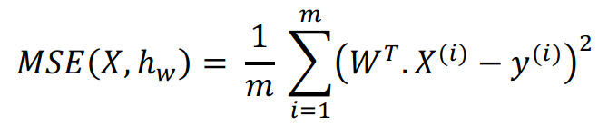

MSE and Normal Equation

Slide 19
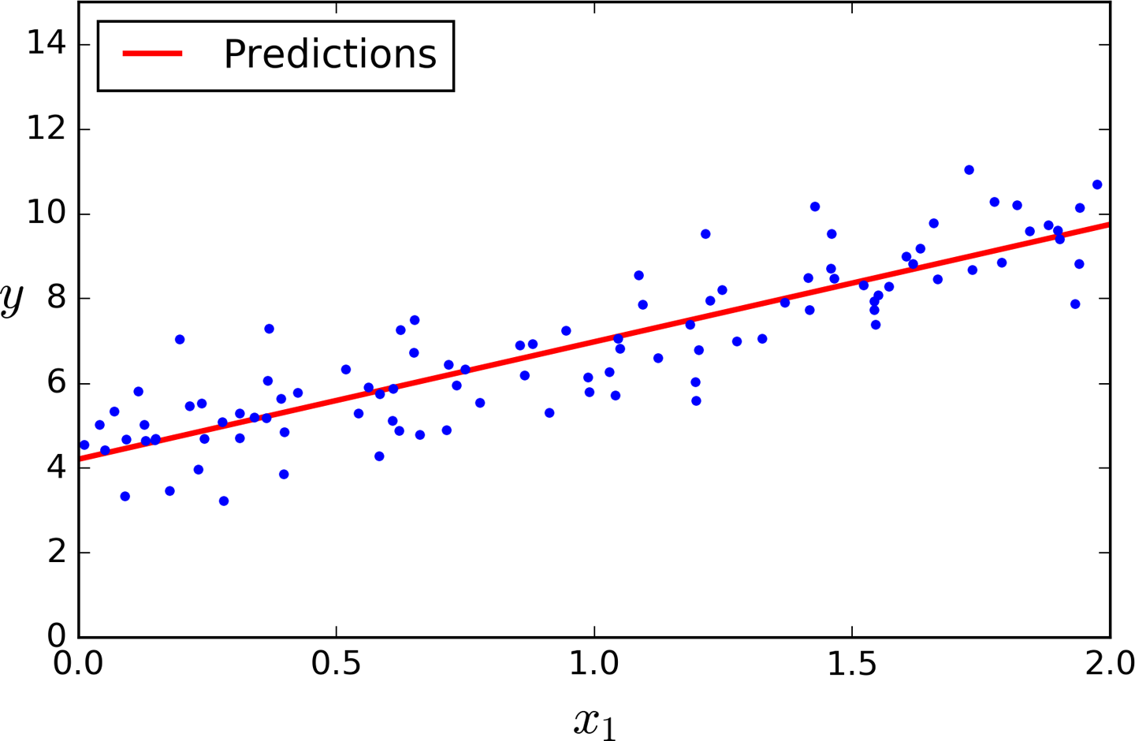
Example

Slide 20
Pros and Cons
Cons:
The computational complexity of linear regression is very high
There is no controlling parameters
Pros:
Prediction is very fast

Slide 21
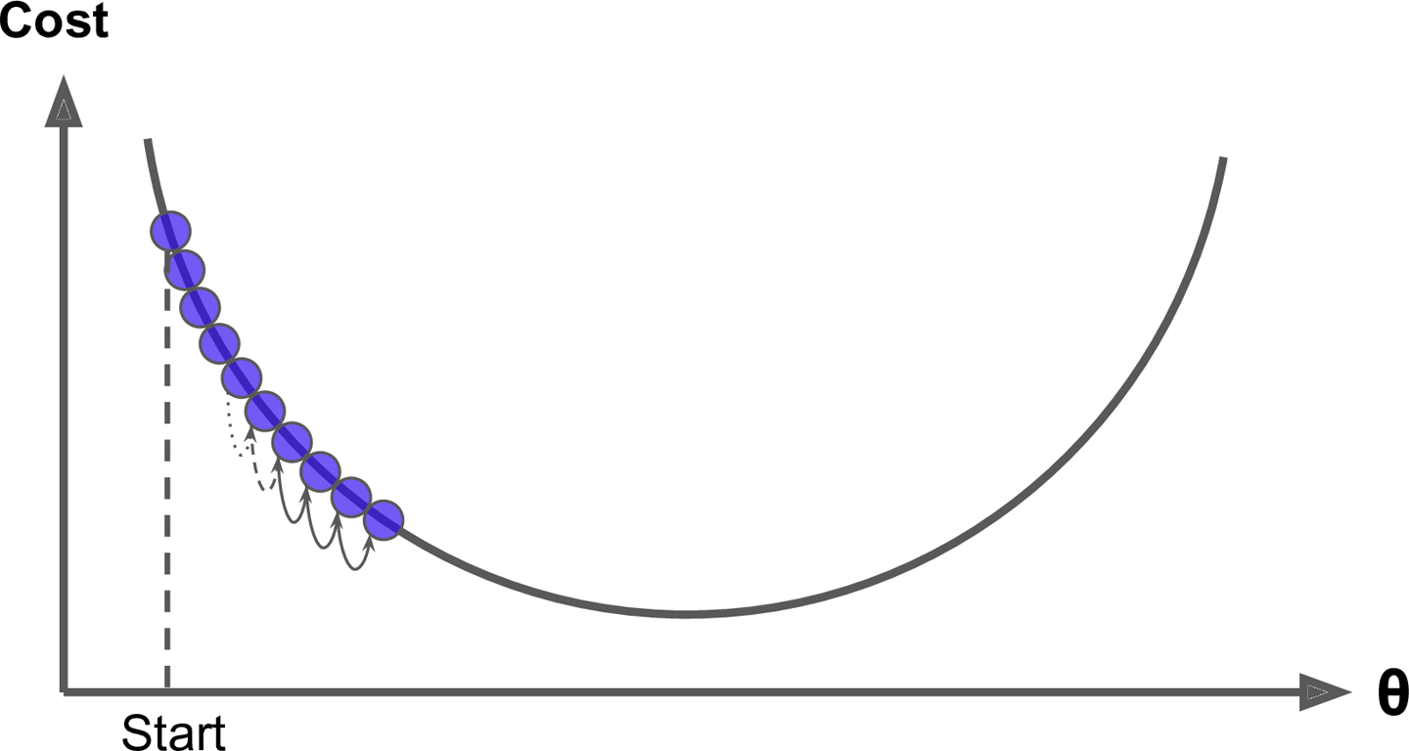
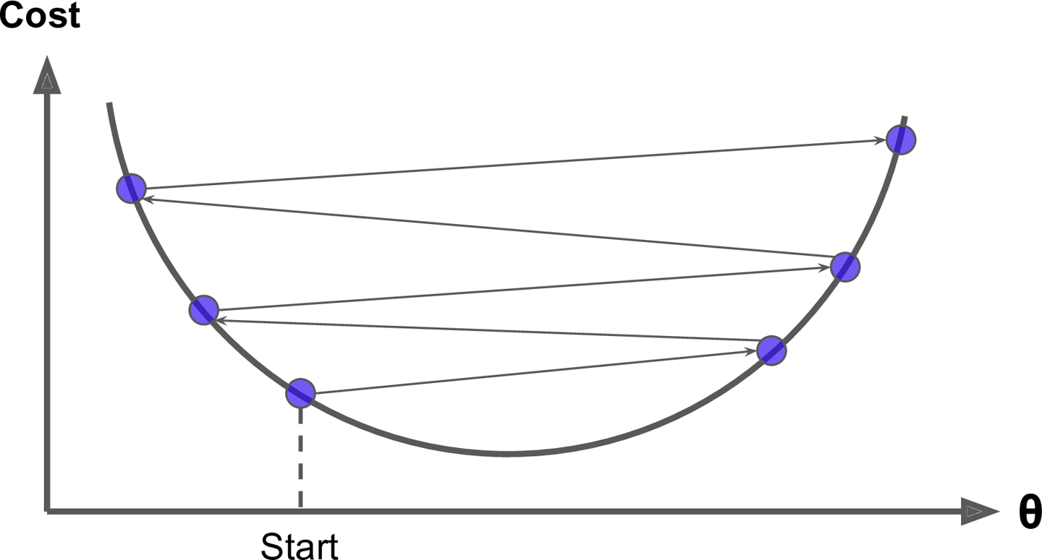
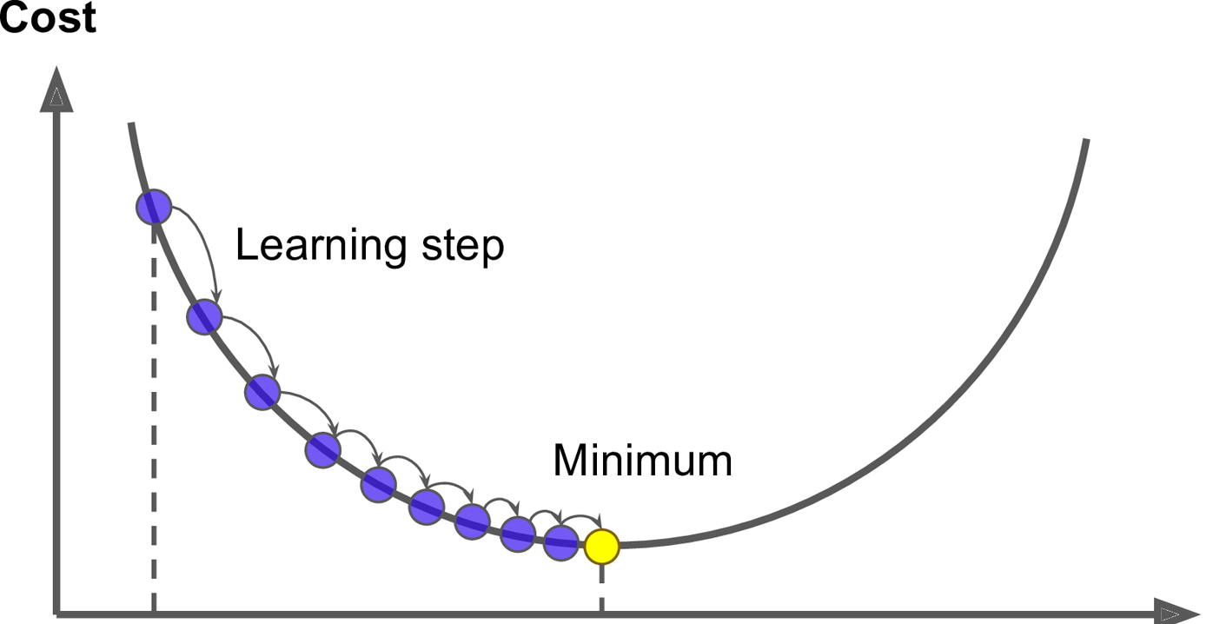
Gradient Descent

Slide 22
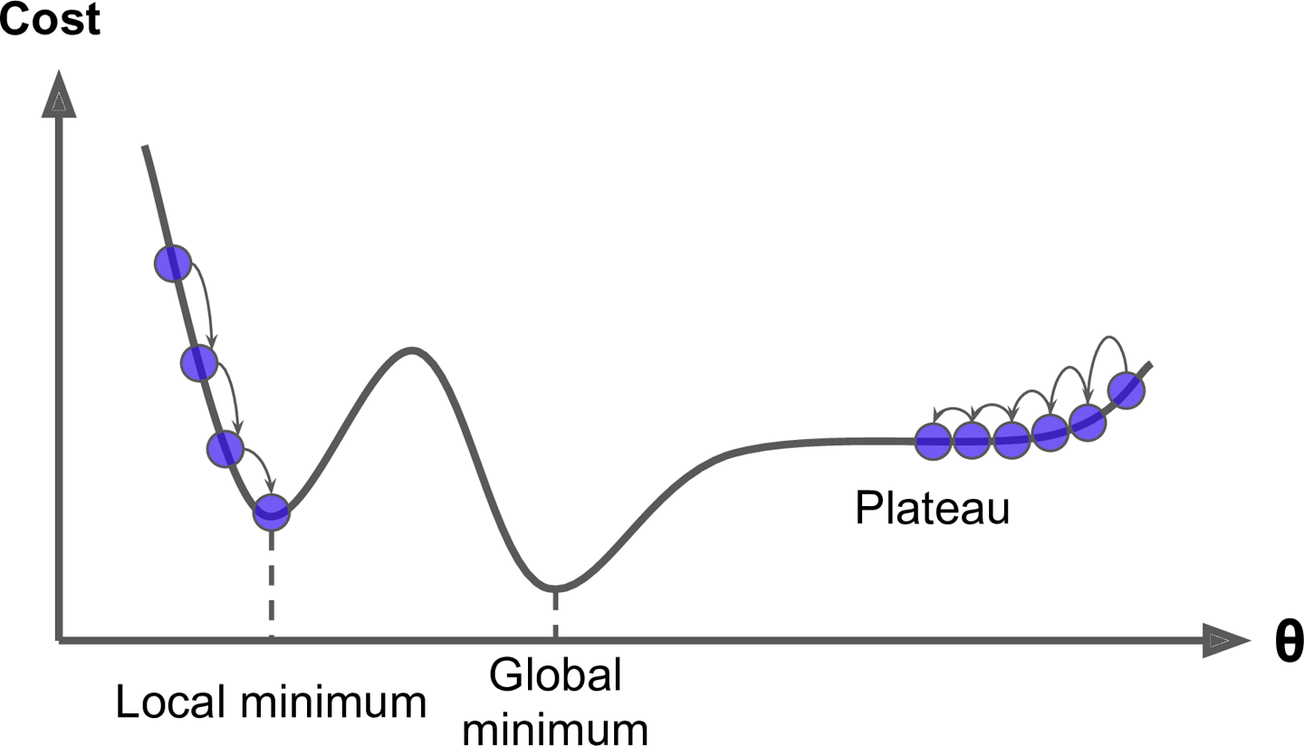
Gradient Descent

Slide 23
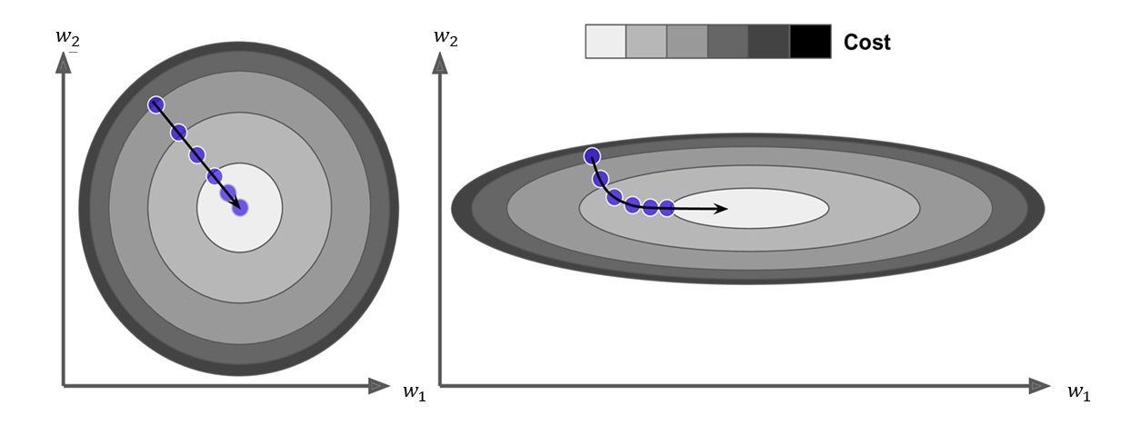
Feature Scale

Slide 24
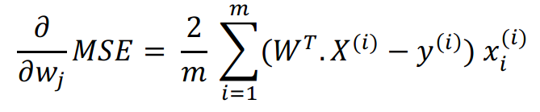
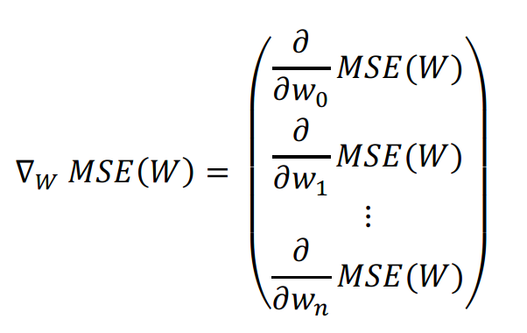
Batch Gradient Descent

Slide 25

Learning Rate
A parameter that can define the size of steps in Gradient Descent.

Slide 26
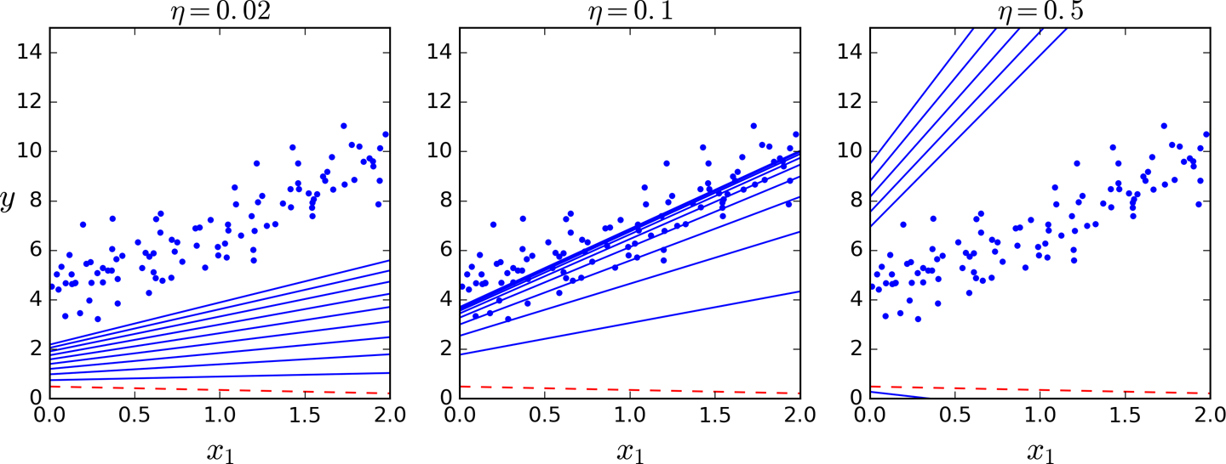
Example

Slide 27
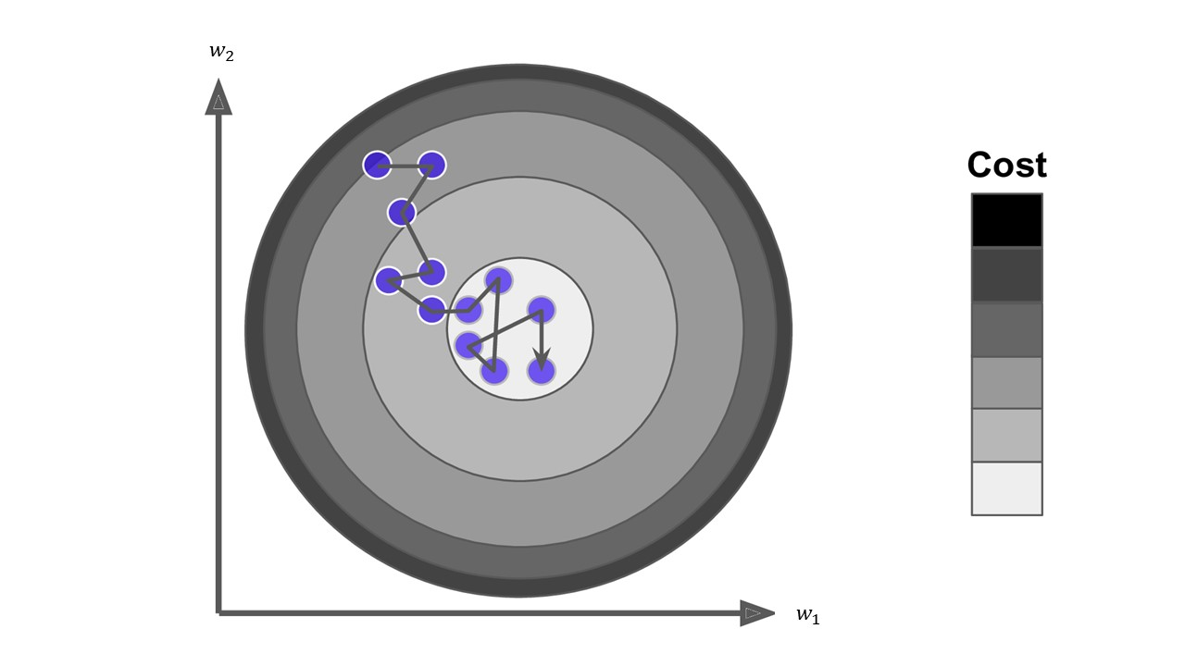
Stochastic Gradient Descent

Slide 28
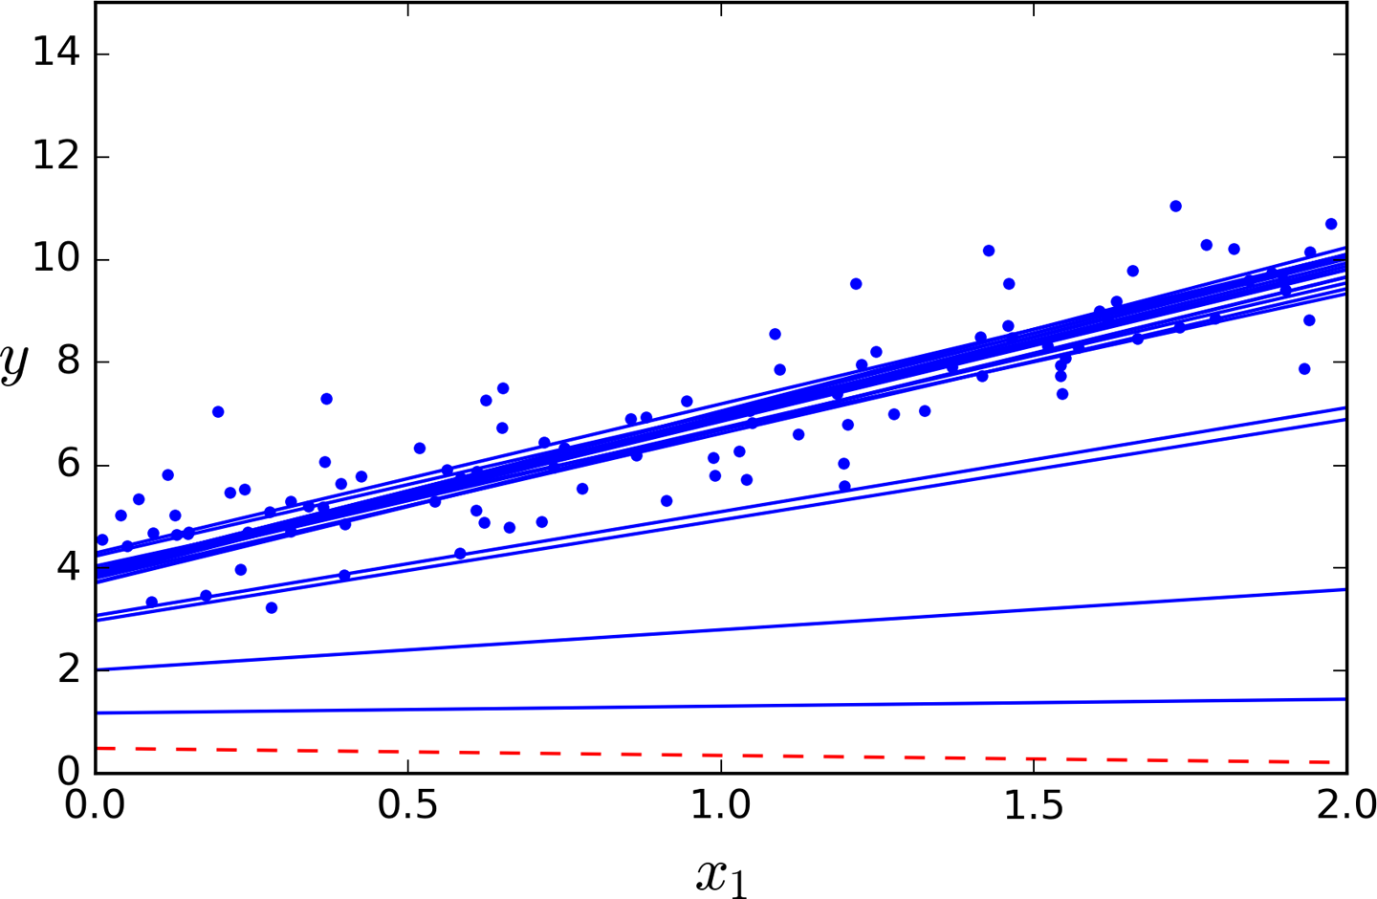
Example

Slide 29
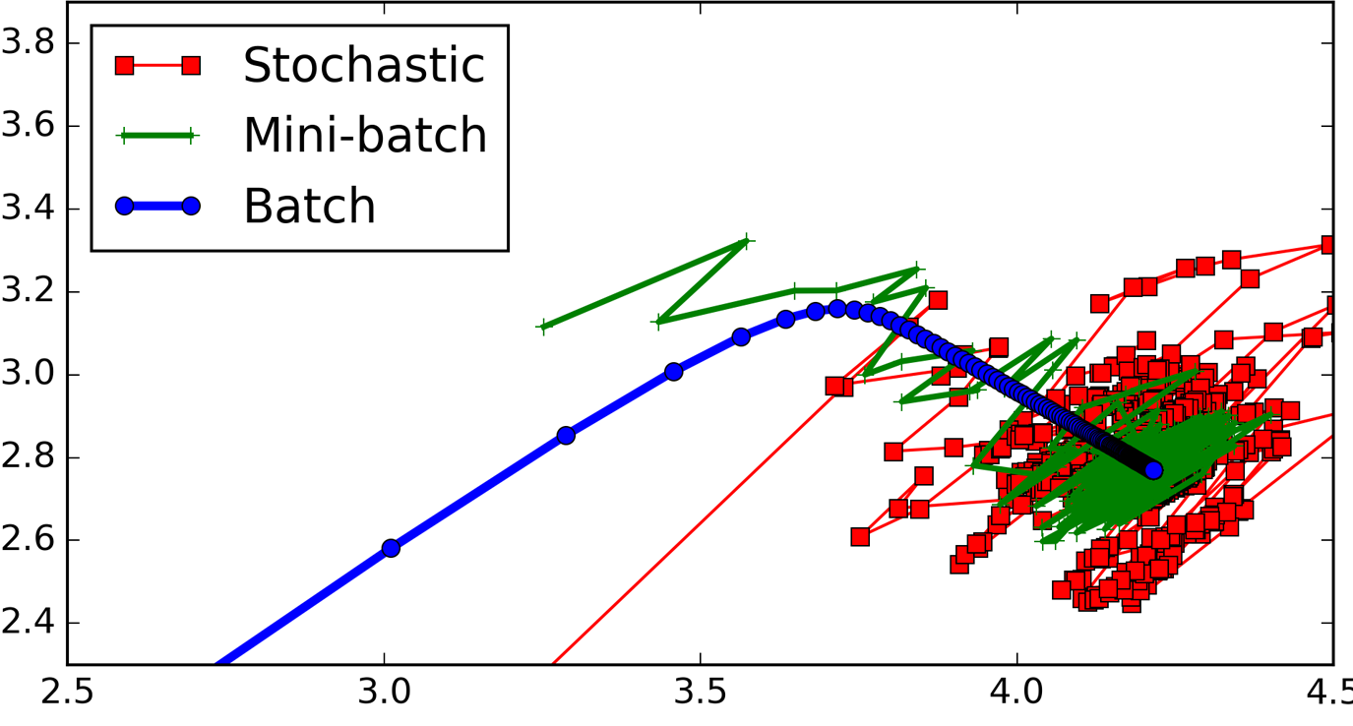
Mini-Batch Gradient Descent
Mini-batch GD computes the gradients on small random sets of instances called mini-batches.

Slide 30
Summary
Algorithm | Large m | Large n | Hyperparameter | Scaling required | sklearn
Normal Equation | Fast | Slow | 0 | No | LinearRegression
Batch GD | Slow | Fast | 2 | Yes | n/a
Stochastic GD | Fast | Fast | ≥2 | Yes | SGDRegressor
Mini-batch GD | Fast | Fast | ≥2 | Yes | n/a

Slide 31
Polynomial Regression

Slide 32
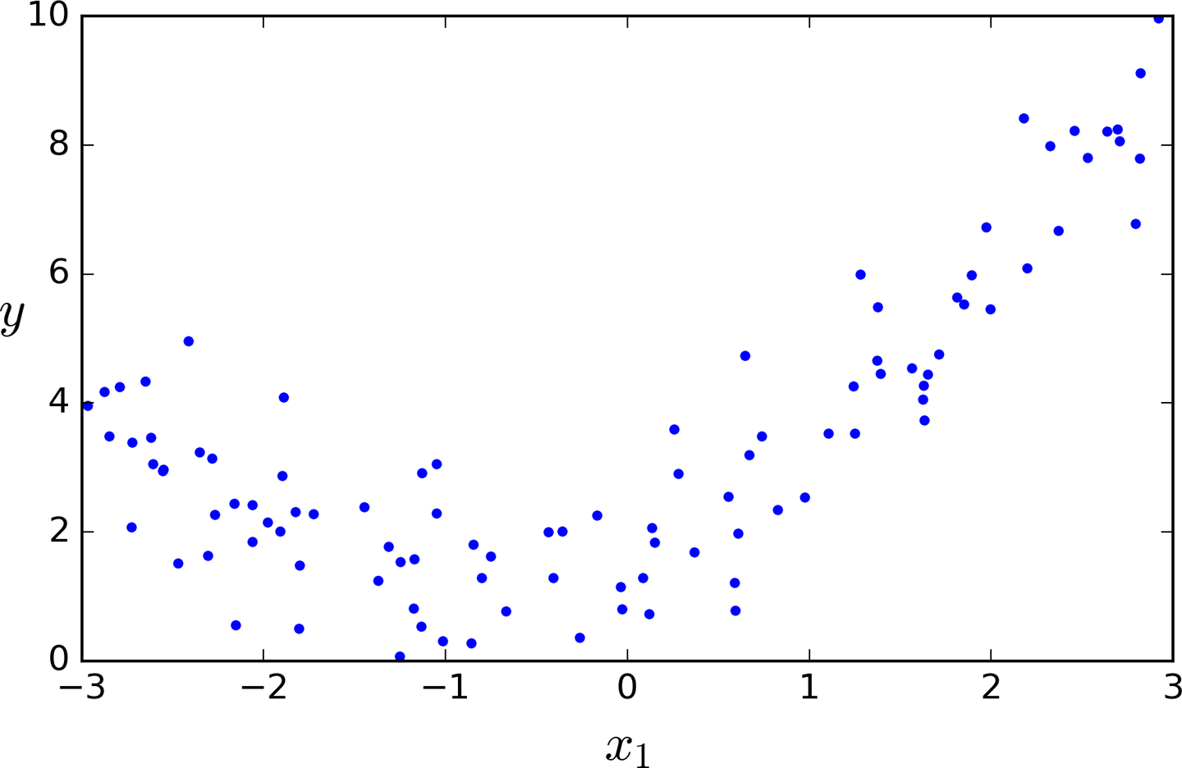
Polynomial Regression

Slide 33
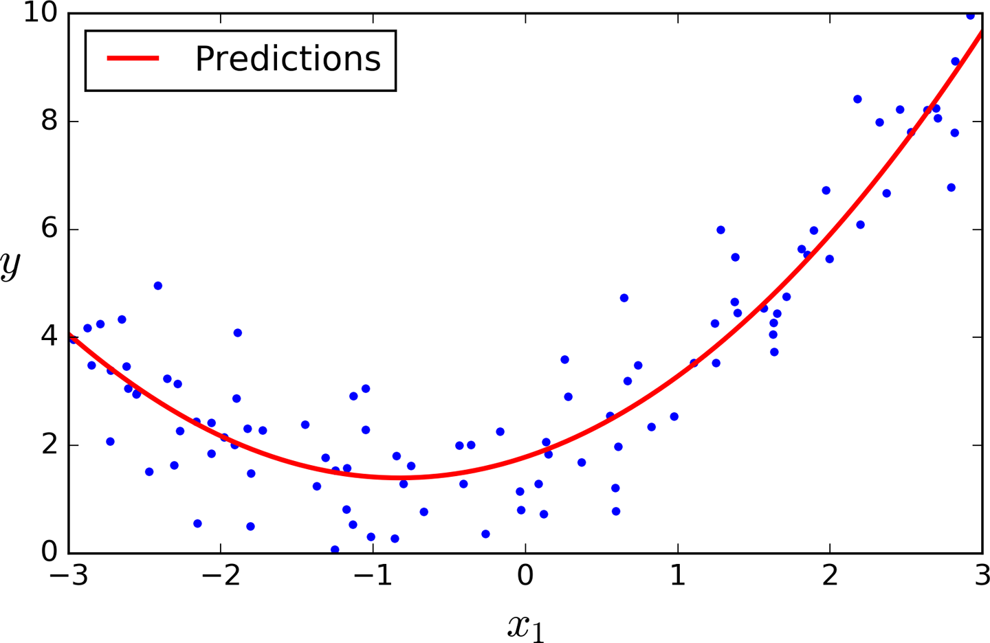
Example

Slide 34
Polynomial Features with Linear Regression
Why would we want to transform our data this way?
To capture interactions between the original features by adding them as features to the linear model.
To make a classification problem easier (we'll see this later).
More generally, we can apply other non-linear transformations to create new features
(Technically, these are called non-linear basis functions)
Beware of polynomial feature expansion with high order as this can lead to complex models that overfit
Thus, polynomial feature expansion is often combined with a
regularized learning method like ridge regression.

Slide 35
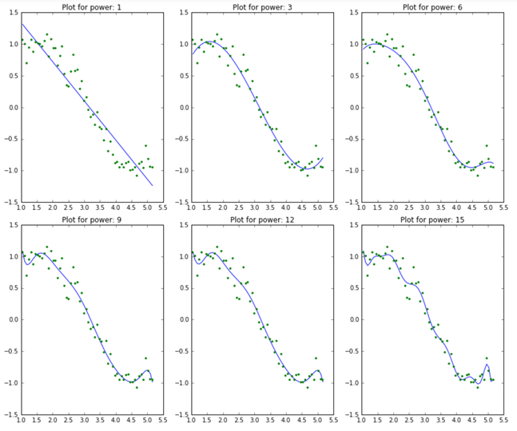
Why Penalize the Magnitude of Coefficients?

Slide 36
Why Penalize the Magnitude of Coefficients?
As the model complexity increases, the models tends to fit even smaller deviations in the training data set.
This leads to overfitting
As the model complexity increases, the size of coefficients increase exponentially.

Slide 37
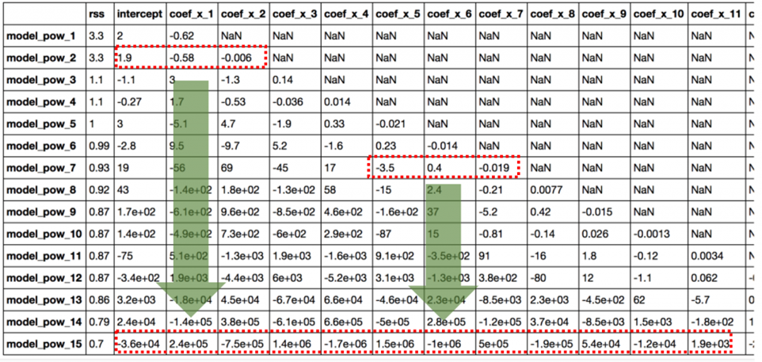

Slide 38
Large coefficient
What does a large coefficient signify?
It means that we’re putting a lot of emphasis on that feature, i.e. the particular feature is a good predictor for the outcome.
When it becomes too large, the algorithm starts modelling intricate relations to estimate the output and ends up overfitting to the particular training data.

Slide 39
Solution
Put a constraint on the magnitude of coefficients can be a good idea to reduce model complexity.

Slide 40
Regularized Linear Model
The fewer degrees of freedom it has, the harder it will be for it to overfit the data.
Linear model:
Weights of the model

Slide 41
Ridge and Lasso
Ridge and Lasso regression are powerful techniques generally used for creating parsimonious models in presence of a ‘large’ number of features. Here ‘large’ can typically mean either of two things:
Large enough to enhance the tendency of a model to overfit
Large enough to cause computational challenges. With modern systems, this situation might arise in case of millions or billions of features

Slide 42
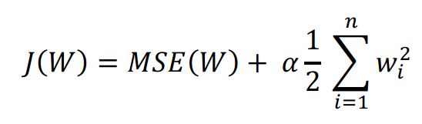
Ridge Regression
A regularization term will be added to the cost function
The tuning parameter α serves to control the relative impact of these two terms on the regression coefficient estimate.
Selecting a good value for α is critical.

Slide 43
α
α = 0:
The objective becomes same as simple linear regression.
We’ll get the same coefficients as simple linear regression.
α = ∞:
The coefficients will be zero. Why? Because of infinite weightage on square of coefficients, anything less than zero will make the objective infinite.
0 < α < ∞:
The magnitude of α will decide the weightage given to different parts of objective.
The coefficients will be somewhere between 0 and ones for simple linear regression.

Slide 44
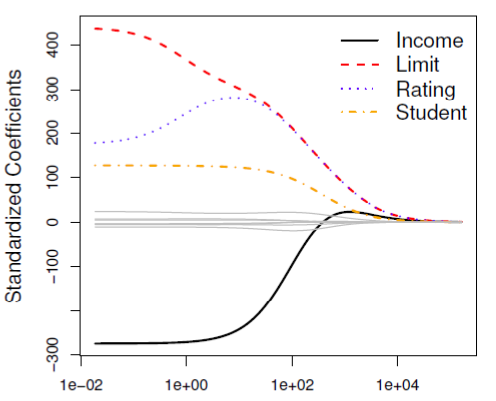
Credit data example

Slide 45
Existence Theorem
There is an existence theorem for ridge regression that states there always exists a α > 0 such that the MSE is less than that of the least squares estimate α = 0.

Slide 46
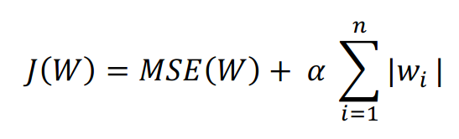
Lasso
Least Absolute Shrinkage and Selection Operator Regression

Slide 47
max_iter
This is the maximum number of iterations for which we want the model to run if it doesn’t converge before.
This exists for Ridge as well.

Slide 48
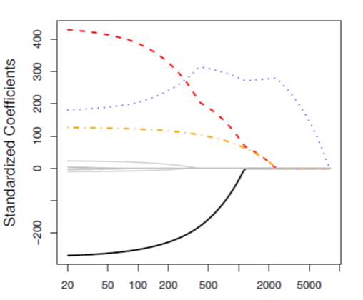
Example

Slide 49
Key Difference
Ridge: It includes all (or none) of the features in the model. Thus, the major advantage of ridge regression is coefficient shrinkage and reducing model complexity.
Lasso: Along with shrinking coefficients, lasso performs feature selection as well. As we observed earlier, some of the coefficients become exactly zero, which is equivalent to the particular feature being excluded from the model.

Slide 50
Typical Use Cases
Ridge: It is majorly used to prevent overfitting. Since it includes all the features, it is not very useful in case of exorbitantly high number features, say in millions, as it will pose computational challenges.
Lasso: Since it provides sparse solutions, it is generally the model of choice (or some variant of this concept) for modelling cases where the number features are in millions or more. In such a case, getting a sparse solution is of great computational advantage as the features with zero coefficients can simply be ignored.

Slide 51
Presence of Highly Correlated Features
Ridge: It generally works well even in presence of highly correlated features as it will include all of them in the model but the coefficients will be distributed among them depending on the correlation.
Lasso: It arbitrarily selects any one feature among the highly correlated ones and reduced the coefficients of the rest to zero. Also, the chosen variable changes randomly with change in model parameters. This generally doesn’t work that well as compared to ridge regression.

